Slide 1
Martyrdom and citizenship in seventeenth-century Arminian women writings
The narratives of Willemken van Wanray (ca. 1573-1647)
Cora van de Poppe

Slide 2
Historical context
Van Wanray’s narrative as Christian martyr story?
New perspective: language driven approach
Citizen-martyr theme
Content

Slide 3
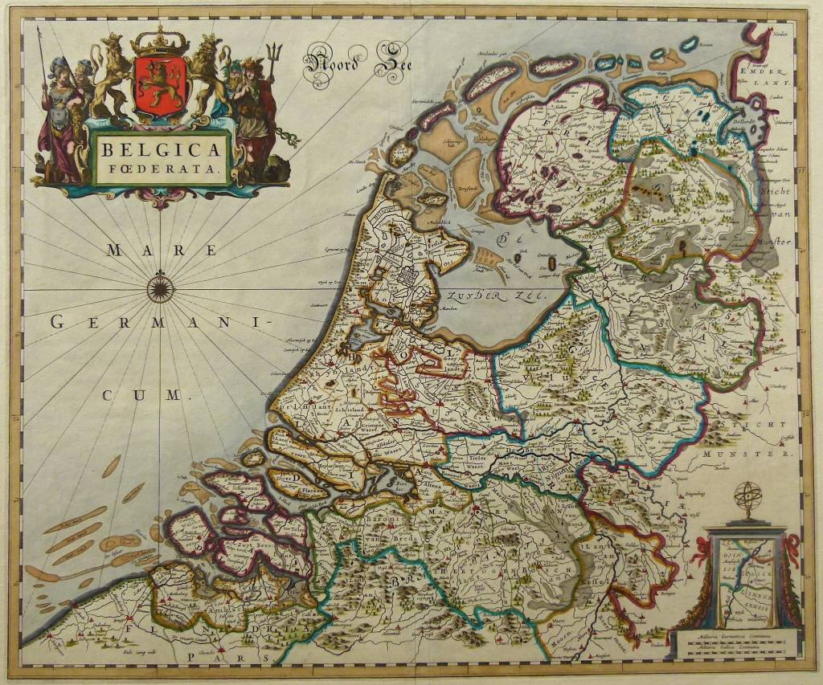
Willemken van Wanray (ca. 1573-1647)
Nijmegen
Old Woman Reading,
Gerard Dou, ca. 1631
1. Historical context

Slide 4
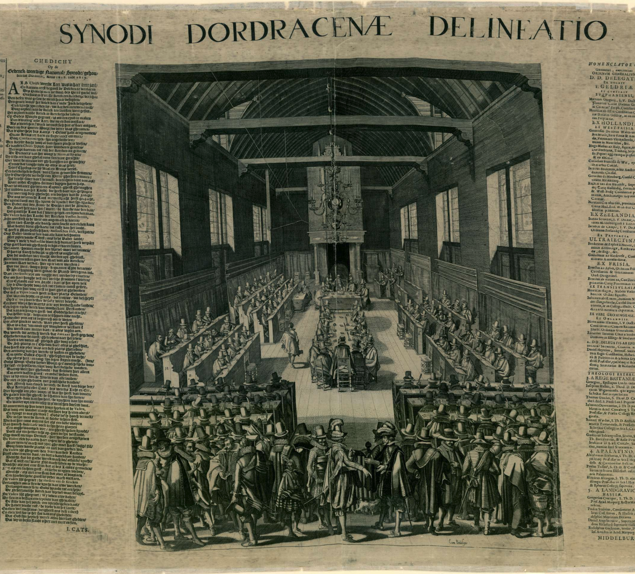
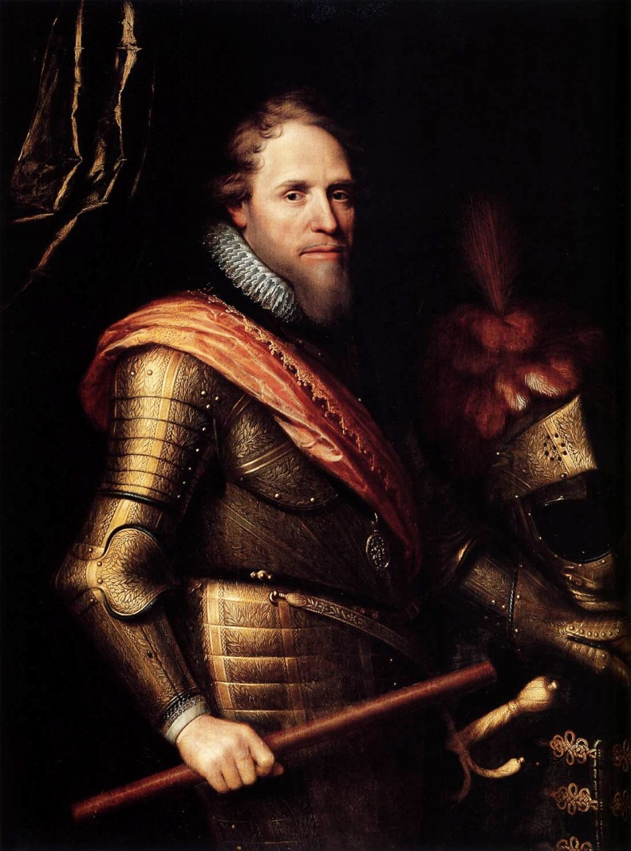
Synod of Dort (1618-1619) & Political coup Nijmegen → Subordination Arminians
Opening of the Synod of Dort, by Francois Schillemans, 1618
Maurice of Orange, by Michiel Jansz. van Mierevelt, 1607
1. Historical context

Slide 5
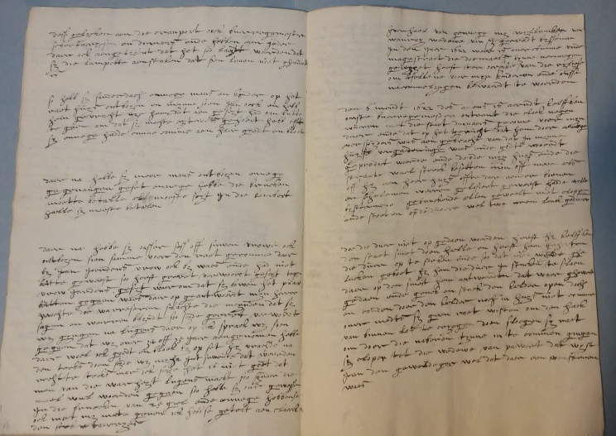
Story of that which happened to me, Willemken van Wanray, widow of Gerradt Bysseman, in the year 16.. […] because of religion, so that it will be preserved for my childeren and our offspring.
2. Martyr story?

Slide 6
Previous research
Women and family memories
Religious function
The role of scripts
i.e. theme’s, plots, textual structure, metaphors, figures of speech
17th century: bible and martyr stories
2. Martyr story?

Slide 7
Our savior Christ preceded us, as example for all believers: we have to pick up our cross, follow after him through all oppression, and remain firm until death.
Van Wanray (Jansen ed.), p. 144
2. Martyr story?

Slide 8
When I was again in the room, I felt myself very weak and appalled. And, in order to be released from the hands of these cruel people, I sent my children […] to good friends to lend 200 guilders.
Van Wanray (Jansen ed.), p. 144
2. Martyr story?

Slide 9
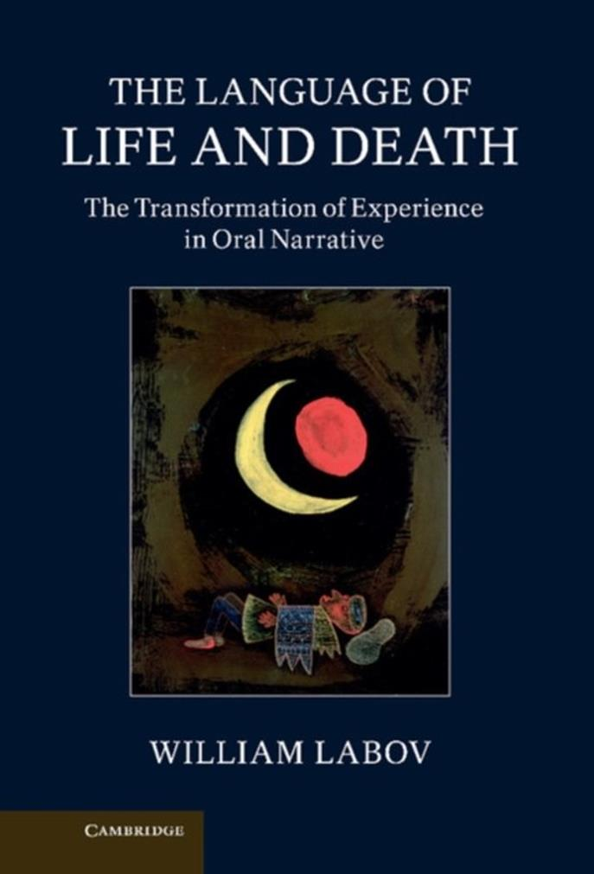
Language driven approach
Positioning through language
Methodology from sociolinguistic narrative analysis (Labov)
→ Citizen-martyr
https://languagedynamics.wp.hum.uu.nl/
3. Linguistic approach

Slide 10
Innocence: passive
October 24th, 1619. So me and my son Jan went to Holdeurn in the territory of Kleve with more men and women. They forbade us to hear the word of God, that we had heard until this time, inside and outside the province. And they forbade this with placards, as they had decided at the Synod of Dort. So, when we were told to learn from the word of God, we could not neglect this.
Van Wanray (Jansen ed.), p. 94
Nijmegen
Kleve
4. Citizen-martyr

Slide 11
Innocence: passive
When the door was not opened, he, Kelffken, did order to bring the city smith and commanded him to break open the door.
Van Wanray (Jansen ed.), p. 102-104
4. Citizen-martyr

Slide 12
Innocence: metapragmatic verb
So, when we were told to learn from the word of God, we could not neglect this.
Van Wanray (Jansen ed.), p. 94
4. Citizen-martyr

Slide 13
Injustice: religious arguments
Thou does not want to treat me worse than the Jews and gentiles treated Paul […]?
Van Wanray (Jansen ed.), p. 122
4. Citizen-martyr

Slide 14
Injustice: quasi modals
The second example that I began to tell was that Daniel did not want to refrain from worshiping and praying to God.
However, I did not have the time to explain this second example. The mayor Kelffken interrupted my words […].
Van Wanray (Jansen ed.), p. 112
4. Citizen-martyr

Slide 15
Injustice: introducers
Then I spoke to Kelffken, complaining about the violence he did to me.
Van Wanray (Jansen ed.), p. 106
Then I said that I did not want to answer that question [….], asking whether this behavior contributed to the protection of widows and orphans.
Van Wanray (Jansen ed.), p. 134
4. Citizen-martyr

Slide 16
Familiar scripts of Christian martyrdom
Variation with verb types and tenses to emphasize:
Innocence
Injustice
→ Van Wanray as citizen-martyr
5. Conclusion

Slide 17
Thank you!
https://languagedynamics.wp.hum.uu.nl/

Slide 18
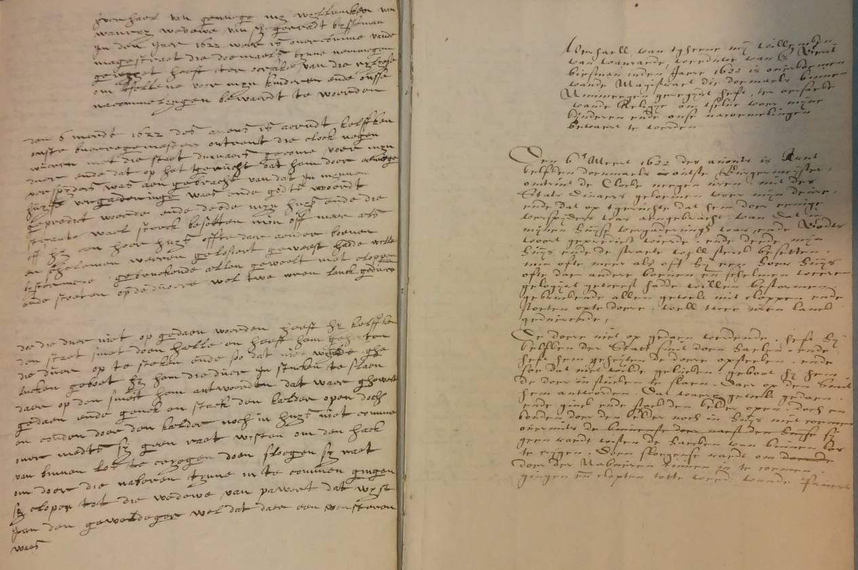
Left: Van Wanray’s handwriting
Right: copy by Christoffel Biesman
Left: History of the Reformation by G. Brandt
Right: The persecution of the Remonstrants, anonymous

Slide 19
Injustice: introducers
And when they had descended from upstairs, I addressed them and asked them what motivated them to do this in my house […].
When he [the mayor] was inside, he called in Jan the supervisor and shut the door, asking why I did not let him in. I answer that I kept my door closed at night for scoundrels.
Van Wanray (Jansen ed.), p. 104

