Slide 1
Language Dynamics in the Dutch Golden Age
Feike Dietz & Marjo van Koppen
http://languagedynamics.wp.hum.uu.nl/

Slide 2
Point of departure
Seventeenth-century Dutch is a melting pot of
the preceding language phase Middle Dutch
new ways to construct words and sentences
due to
natural changes in the language (i.e. decline of case)
artificial changes: Dutch developed into the Lingua Franca of the newly formed Dutch Republic → migration, rise of new literary genres, new vernacular domains (religion, science), standardization processes.
Within this dynamic linguistic period we see a lot of variation.

Slide 3
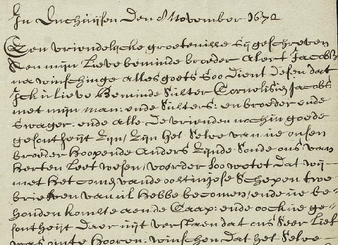
Historical socio-linguistic perspective
Variation between groups of language users (gender, class)
Example: Letters as Loot

Slide 4
Our perspective
Variation within authors: intra-author variation
Example: Vondel and his such/so-adjective-a constructions:
Zo harden proef
Zulcken harden proef
Zoo kort een tijd
Zulck een’ korten tijt

Slide 5
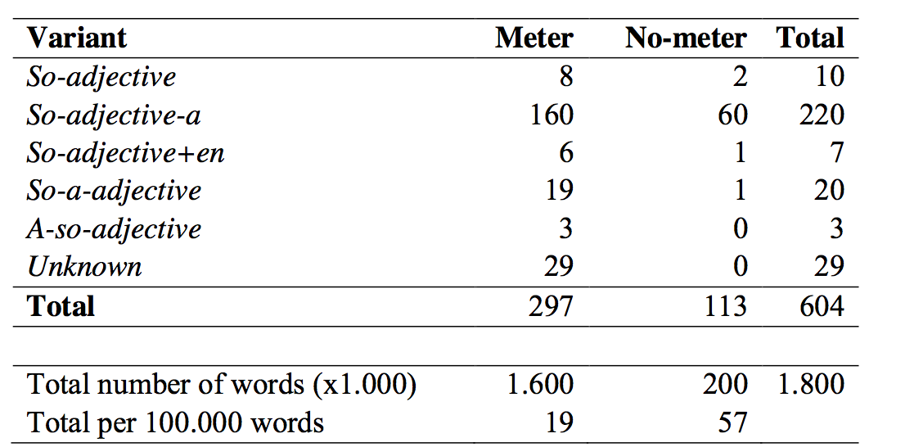
Interdisciplinary approach
Internal language system
Literary / cultural context

Slide 6
Questions
Research questions:
What are the patterns of intra-author variation in 17th century Dutch?
How can we account for intra-author variation in this period?
Hypothesis:
The patterns of intra-author variation in 17th-century Dutch result from the interaction between the internal language system of a language user and the social/literary-cultural contexts the language is used in. The internal language system of authors makes available a particular range of variation, which is then systematically and pattern-wise used by authors in different contexts.

Slide 7
Three subprojects
3

Slide 8
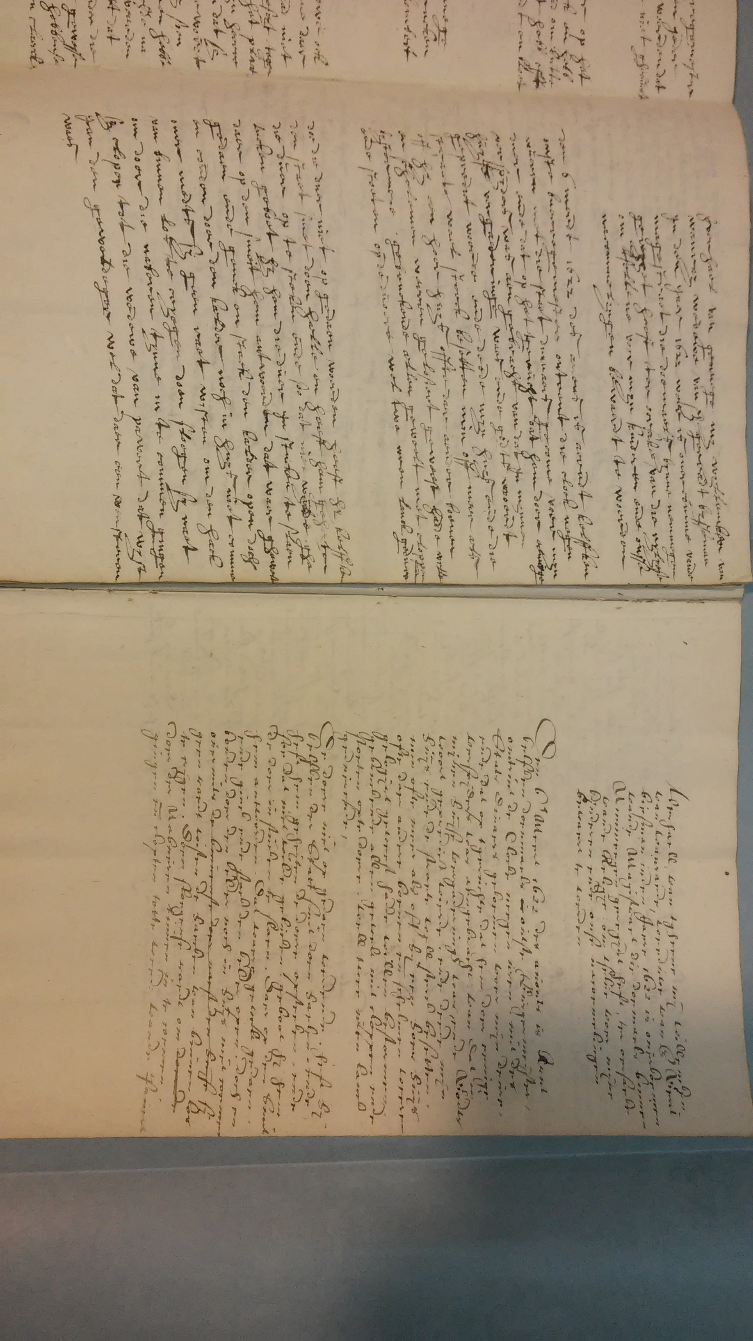
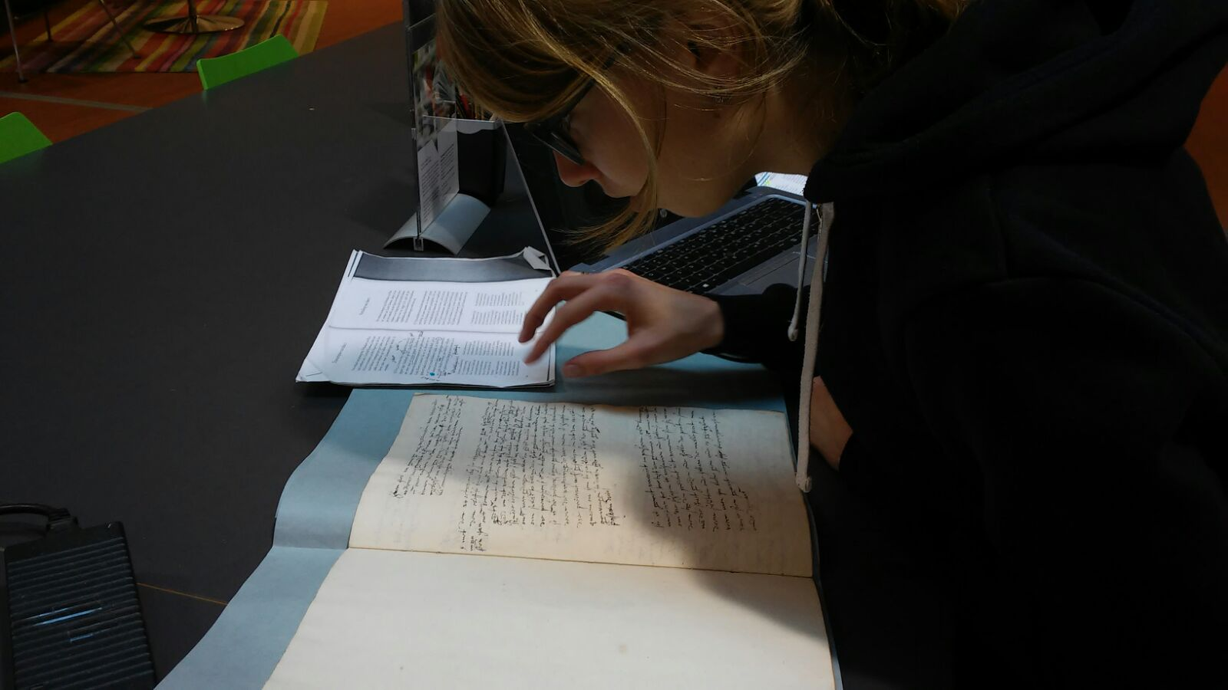
Subproject 2: social and literary-cultural context
Influence of different contexts on variation
Function of variation
Case study: the memoires of the remonstrant widow Willemken van Wanray (ca. 1573-1647)
Language as weapon

Slide 9
Function of variation
Ende deede myn huys ende die straete wael sterck
And did my house and the street well strongly
besetten, min of meer alsoff hy een hoerhuys offte
occupy, more ore less as if he a whore house if
daer aender boeven en schelemen waeren gelosiert geweest
there other thieves and knaves were stayed been
hadde wille bystormmene.
had want to storm.
‘He occupied my house as if he wanted to assault a house of whores or thieves’
→ Doubling construction as marker of an evaluative section

Slide 10
Influence of contexts
Van Wanray: Doe die duer niet op gedaen woerden..
woerden: preterite
Brother in law: De doer niet op gedaen wordende..
wordende: present participle/ participium praesentis
‘When the door wasn’t opened..’

Slide 11
Language Dynamics in the Dutch Golden Age
http://languagedynamics.wp.hum.uu.nl/

